Slide 1
Selecting best neighborhood for daycare in Seattle
Tze Yeoh

Slide 2
Problem statement
Seattle has had a huge population growth in last 5 years.
Childcare services, in particular daycare for working parents have not caught up in the growth.
There is a shortage of daycare facilities in Seattle, with long waitlists, and parents driving out of the city for their childcare needs.
There is a huge demand for daycare, so I will use my project to analyze publicly available datasets to determine the best neighborhood to start a daycare.

Slide 3
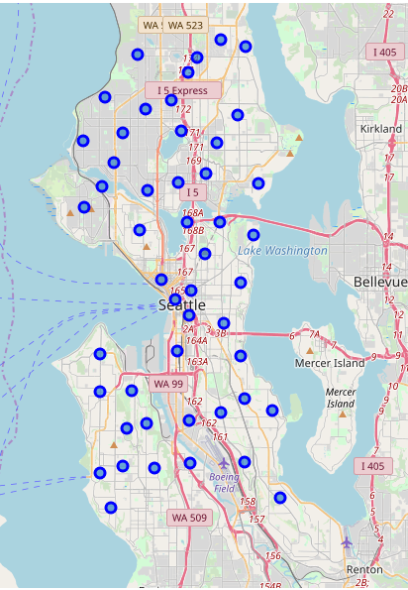
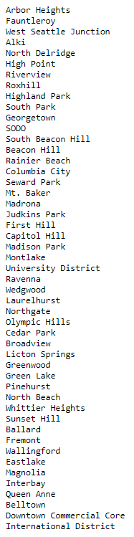
Locate and map all neighborhoods in Seattle
Using City of Seattle data, I obtained data on 49 neighborhoods.
The coordinates of each neighborhood was plotted out in folium in order to visualize the size and scope of the candidate neighborhoods.
Some data cleaning activity was done on the default coordinates of neighborhoods to allow for best venue results when using Foursquare.
Utilizing google maps, I adjusted the coordinates of the neighborhoods to be as centered as possible.
Neighborhood List

Slide 4
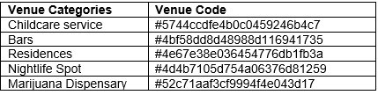
Determine Foursquare venue criteria
I analyzed Foursquare venue categories on their webpage to isolate to a few venue criteria for selecting daycares.
Residence venues were selected to assess the demand portion of the equation in the neighborhood. Higher concentration of residences should have higher demand for daycares.
Bars, Nightlife Spots, Dispensary venues were selected so that I could determine the concentration of undesirable venues in the neighborhood.
Childcare services were selected so that I could determine whether this is a concentration of other daycare services already in the neighborhood.
I used the venue codes for the selected categories within my Foursquare API.

Slide 5
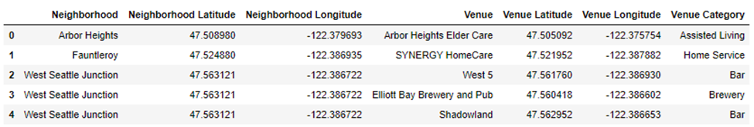
Run Foursquare API against all neighborhoods
An algorithm to pull all nearby venues within a radius of 600 meters to each neighborhood was written.
The algorithm was repeated on all 49 neighborhoods, and data consolidated into the a dataframe for further analysis
Sample of header of the dataframe displayed.

Slide 6
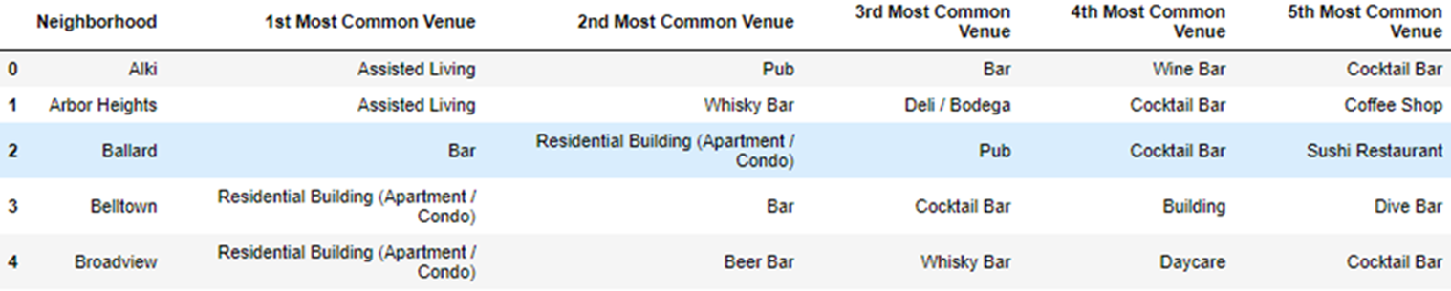
Rank each neighborhood against venues
Using one-hot encoding method, all venues were grouped by neighborhood.
The venues were arranged by 1st most common venue to 5th most common venue.
Sample of header of the dataframe displayed.

Slide 7
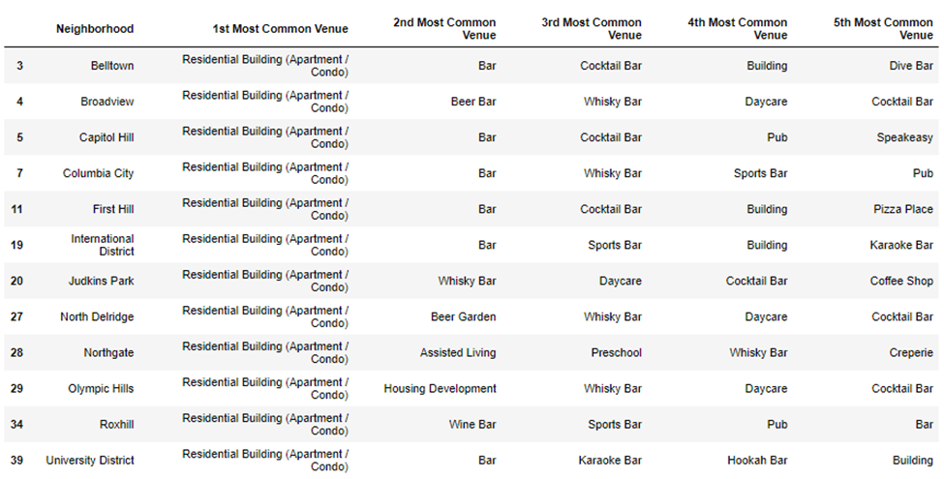
Select high residential and low non-children friendly venues neighborhoods
Data was filtered by “residences” as the 1st most common venue in neighborhoods.
Data was then further filtered by neighborhoods that did NOT contain non-children friendly venues like alcoholic, dance club and/or marijuana related venues.
The final shortlisted neighborhoods are shown on the table at the bottom.

Slide 8
Recommendation: Final neighborhood selected based on demographics
The final shortlisted neighborhoods were aligned against the City of Seattle dataset.
The neighborhoods were sorted by highest number of population and families, with highest ranked neighborhood is selected as the neighborhood for daycare.
“Olympic Hills” was selected based on the demographics data as the best neighborhood to start a daycare.

Slide 9
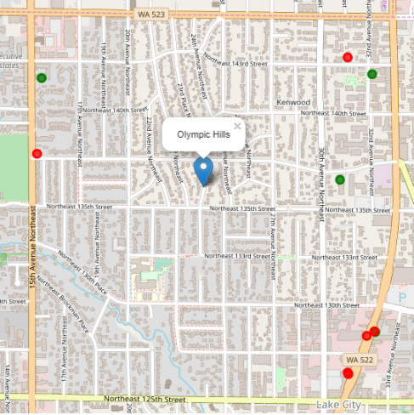
Extra credit
As a thought exercise, venues were mapped out in the selected neighborhood:
Residences (in green)
Non-children friendly (in red)
A rough search area was drawn in light green that is worth additional scouting to determine actual storefront location.

